Slide 1
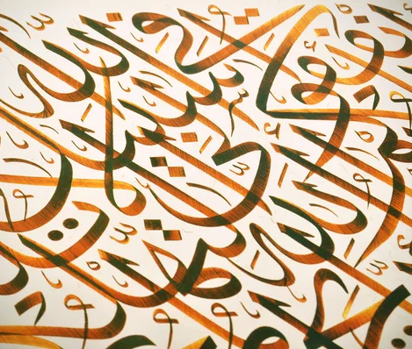
From Script to Digital: A Deep Learning Approach to Arabic Handwriting Recognition
Hamza Abushahla, 90279
Ariel Justine Panopio, 88568
Layth Al-Khairulla, 87225
Notes:
Ariel

Slide 2
Table of Contents
Introduction and Motivation
Literature Review
Methodology
Results and Analysis
Challenges and Limitations
References
Conclusion and Future Work
Notes:
Ariel

Slide 3
Introduction and Motivation

Slide 4
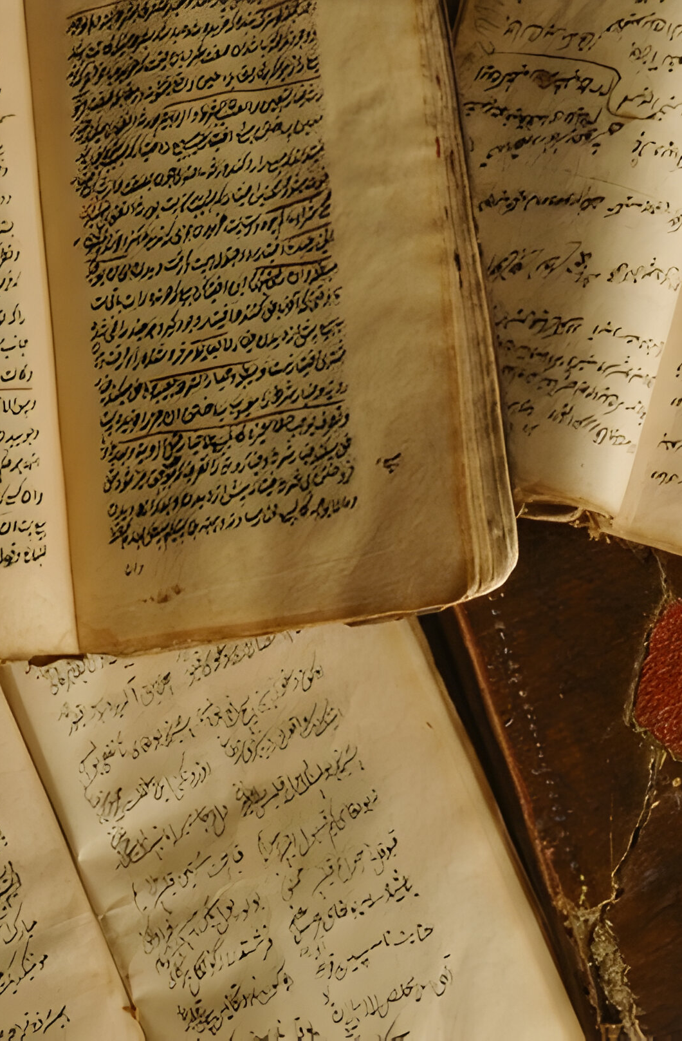
Introduction
What is Arabic handwritten text recognition (HTR) ?
A system to convert Arabic handwritten text into digital formats for use in archives, education, and automation.
Why is it important?
Arabic is spoken by over 400 million people, the official language in 25 countries, and one of the six UN languages.
Critical for preserving cultural heritage and enhancing digital workflows.

Slide 5
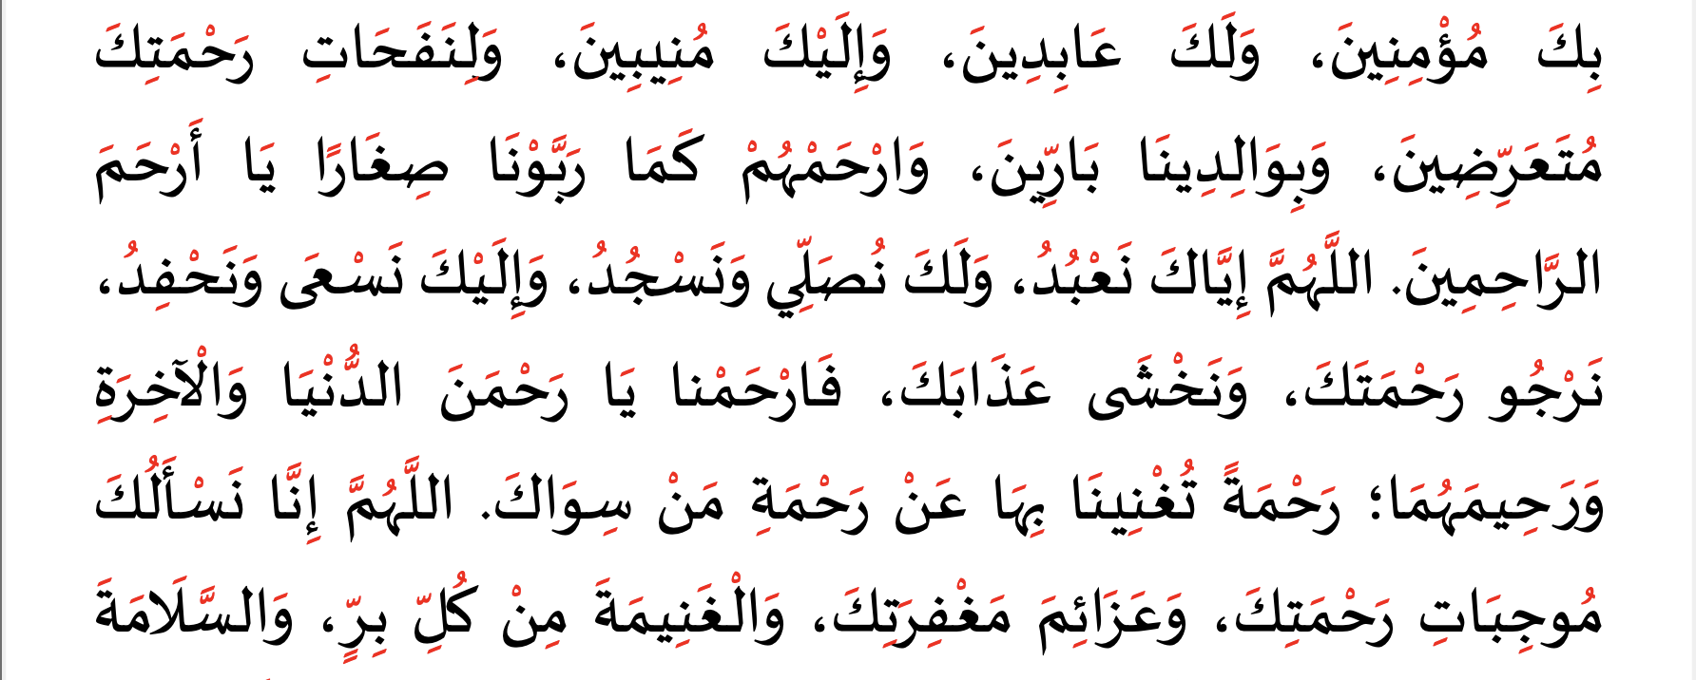
Motivation
Challenges:
Cursive script with context-dependent letter shapes.
Diacritical marks that drastically alter meaning.
Diverse handwriting styles influenced by culture and region.
Opportunities:
Digitizing historical manuscripts for cultural preservation.
Automating administrative processes and large-scale data analysis.
Supporting education by enabling easier access to resources.
Figure 1: Sample Arabic Text with Diacritics in Red

Slide 6

Our Research Question
How can we develop a robust deep learning-based system to accurately recognize Arabic handwritten text, overcoming the challenges posed by its cursive nature, diacritical complexity, and diverse writing styles?
Notes:
Ariel

Slide 7
Literature Review

Slide 8
Levels of Handwritten Text Recognition [1]
Character-Level Recognition:
Recognizes isolated characters.
Challenges: Requires segmentation; struggles with cursive scripts like Arabic.
Word-Level Recognition:
Processes entire handwritten words as units.
Advantages: Reduces reliance on segmentation; suitable for moderately complex scripts.
Line-Level Recognition:
Transcribes entire lines of text.
Benefits: Captures contextual relationships; handles cursive connections better.
Page-Level Recognition:
Integrates layout analysis to process entire document pages.
Use Case: Complex, structured documents like manuscripts.
Notes:
Layth until here

Slide 9
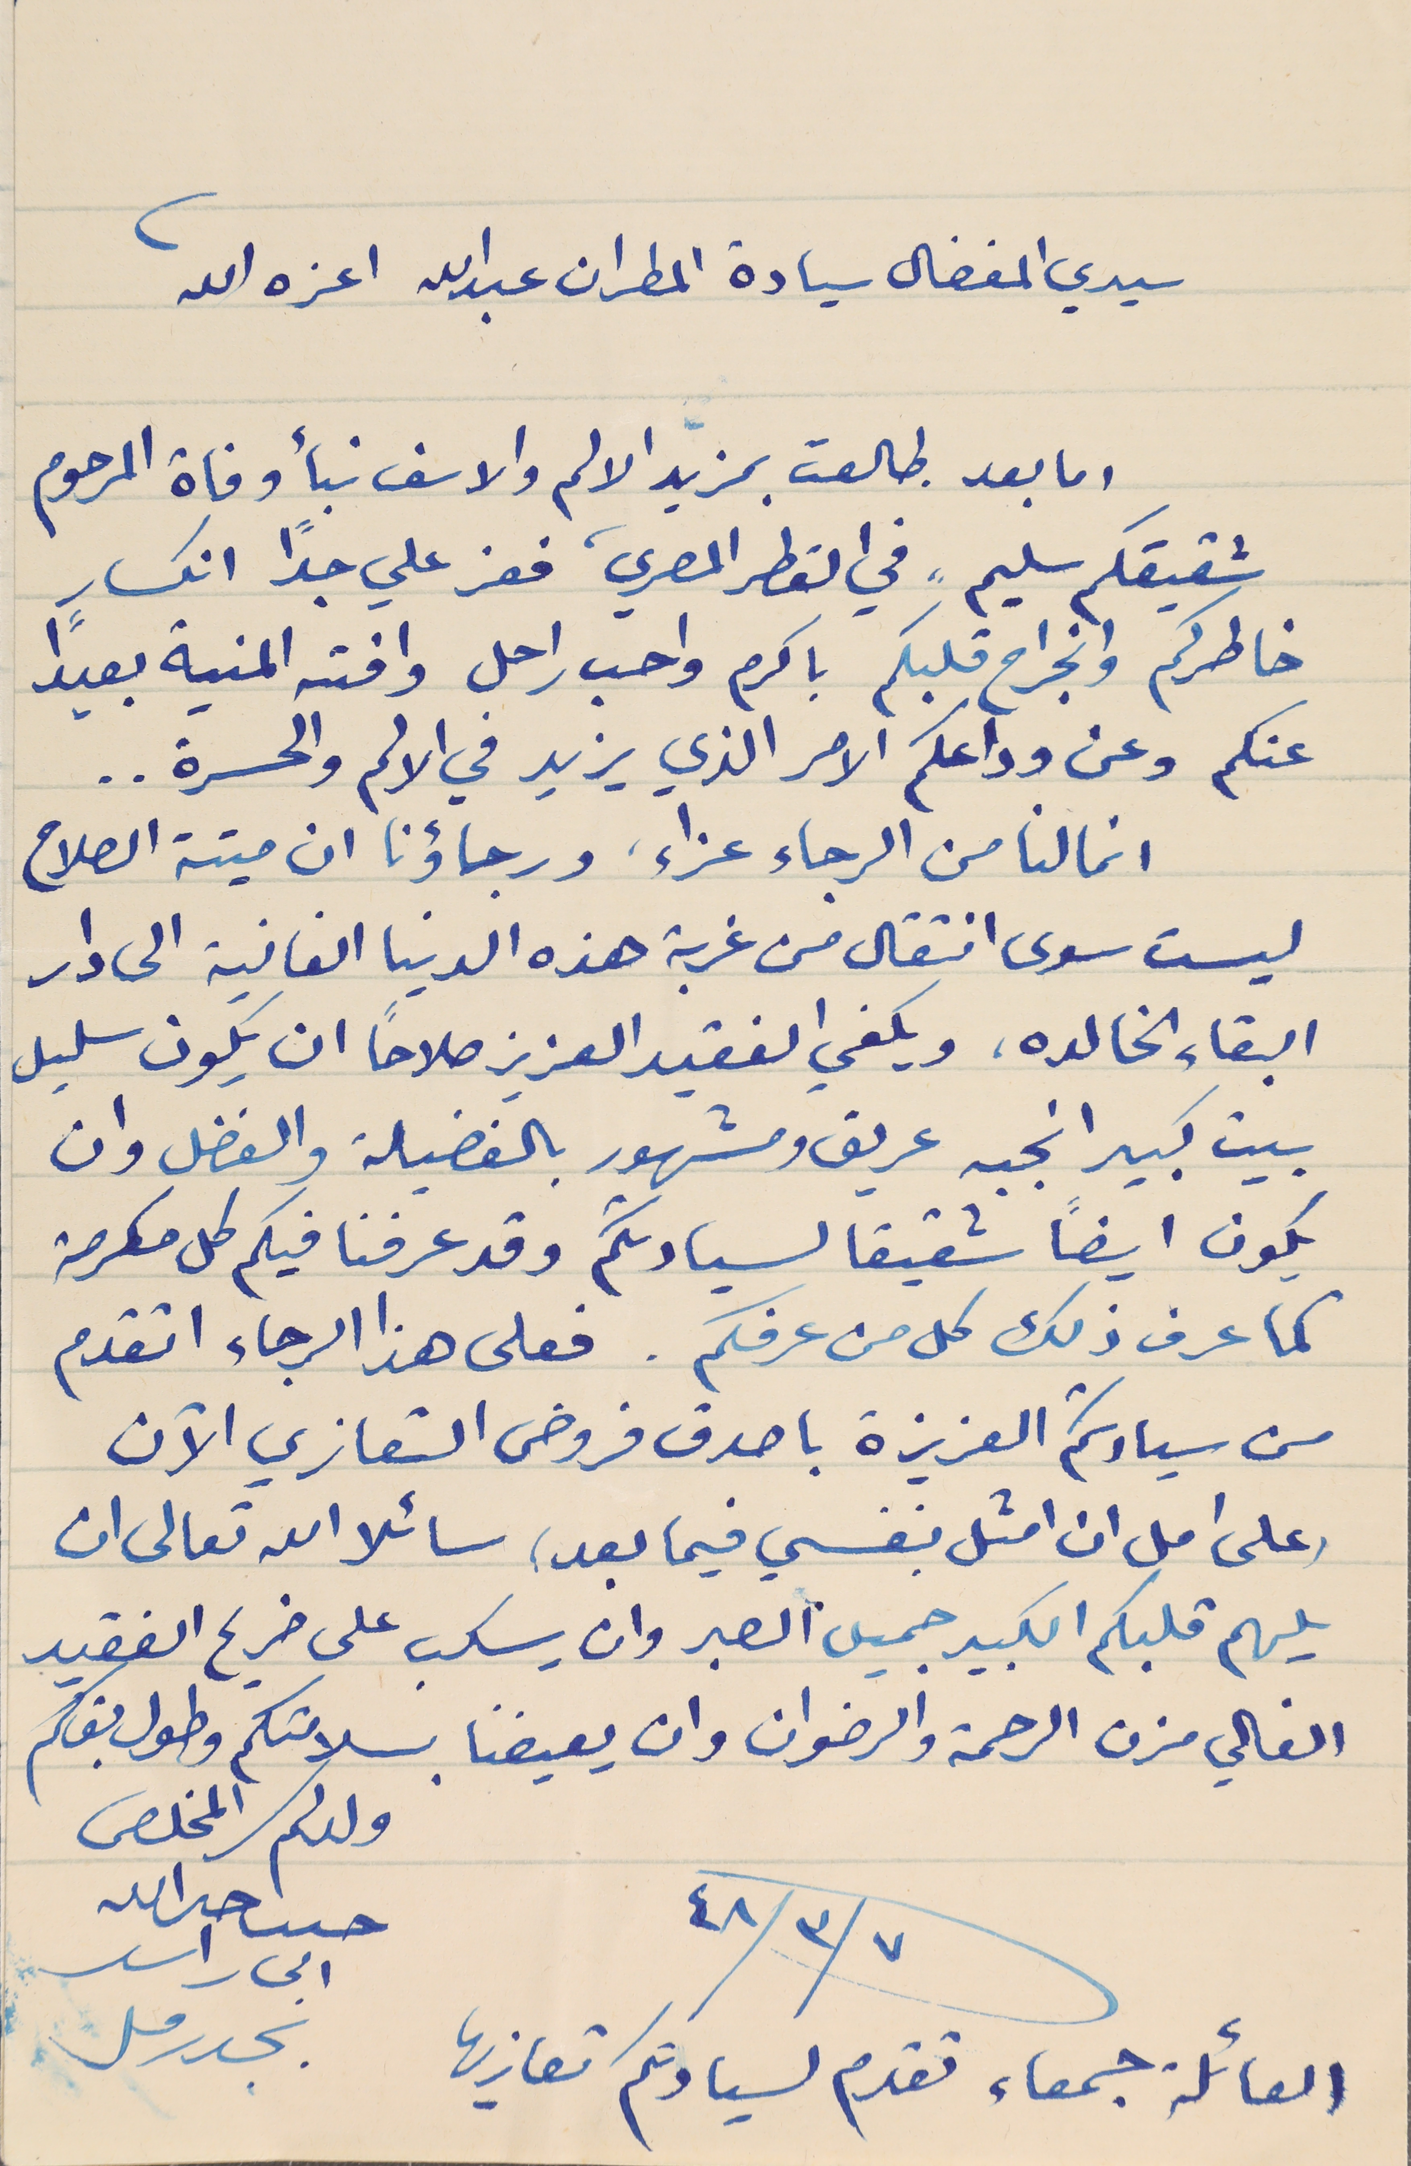
Muharaf: Manuscripts of Handwritten Arabic Dataset for Cursive Text Recognition [2]
Three Convolutional Neural Network (CNN)-Based Models for Full Page HTR:
Start of Line (SOL) Network:
A CNN for detecting the starting coordinates of each text line in a page image.
Line Follower (LF) Network:
A CNN that tracks the trajectory of text lines by iteratively predicting the next coordinates and orientation.
Handwriting Recognition (HW) Network:
A CNN–Bidirectional Long Short-Term Memory (BiLSTM) model trained with Connectionist Temporal Classification (CTC) loss for end-to-end text recognition.
Figure 2: Sample Page Scan from the Muharaf Dataset [2]
Notes:
Hamza

Slide 10
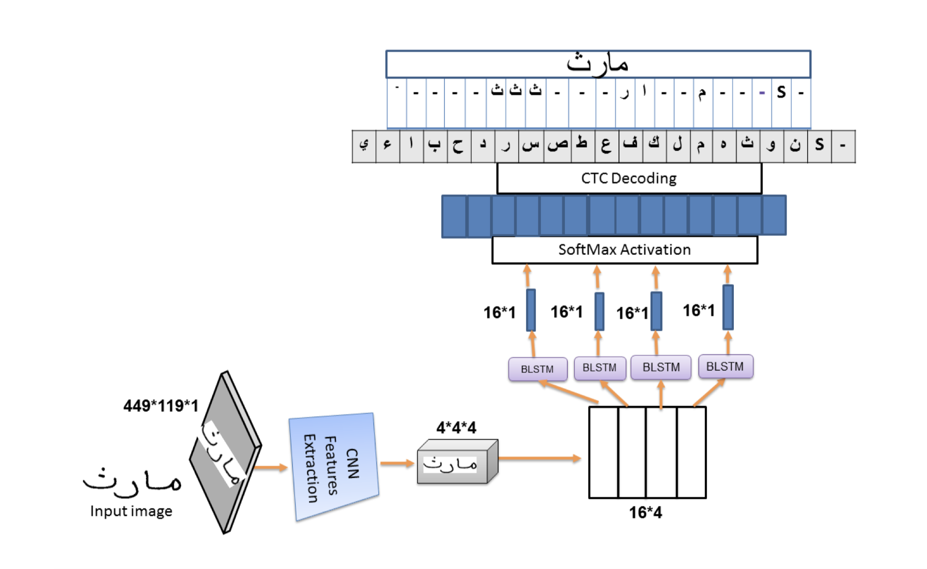
CTC Loss and Decoding
CTC Loss:
Enables sequence-to-sequence learning without pre-aligned data.
Uses a "blank" token for handling gaps between characters.
Decoding:
Greedy: Chooses the most probable character at each step.
Beam Search: Considers multiple sequences for better accuracy.
Figure 3: CNN-BiLSTM Network with CTC loss and Decoding (Adopted from [3])
Decodes the most likely sequence by collapsing repeated characters and removing blanks (e.g., "hh__ee_ll_oo" → "hello").
Notes:
Predicts character probabilities at each time step

Slide 11
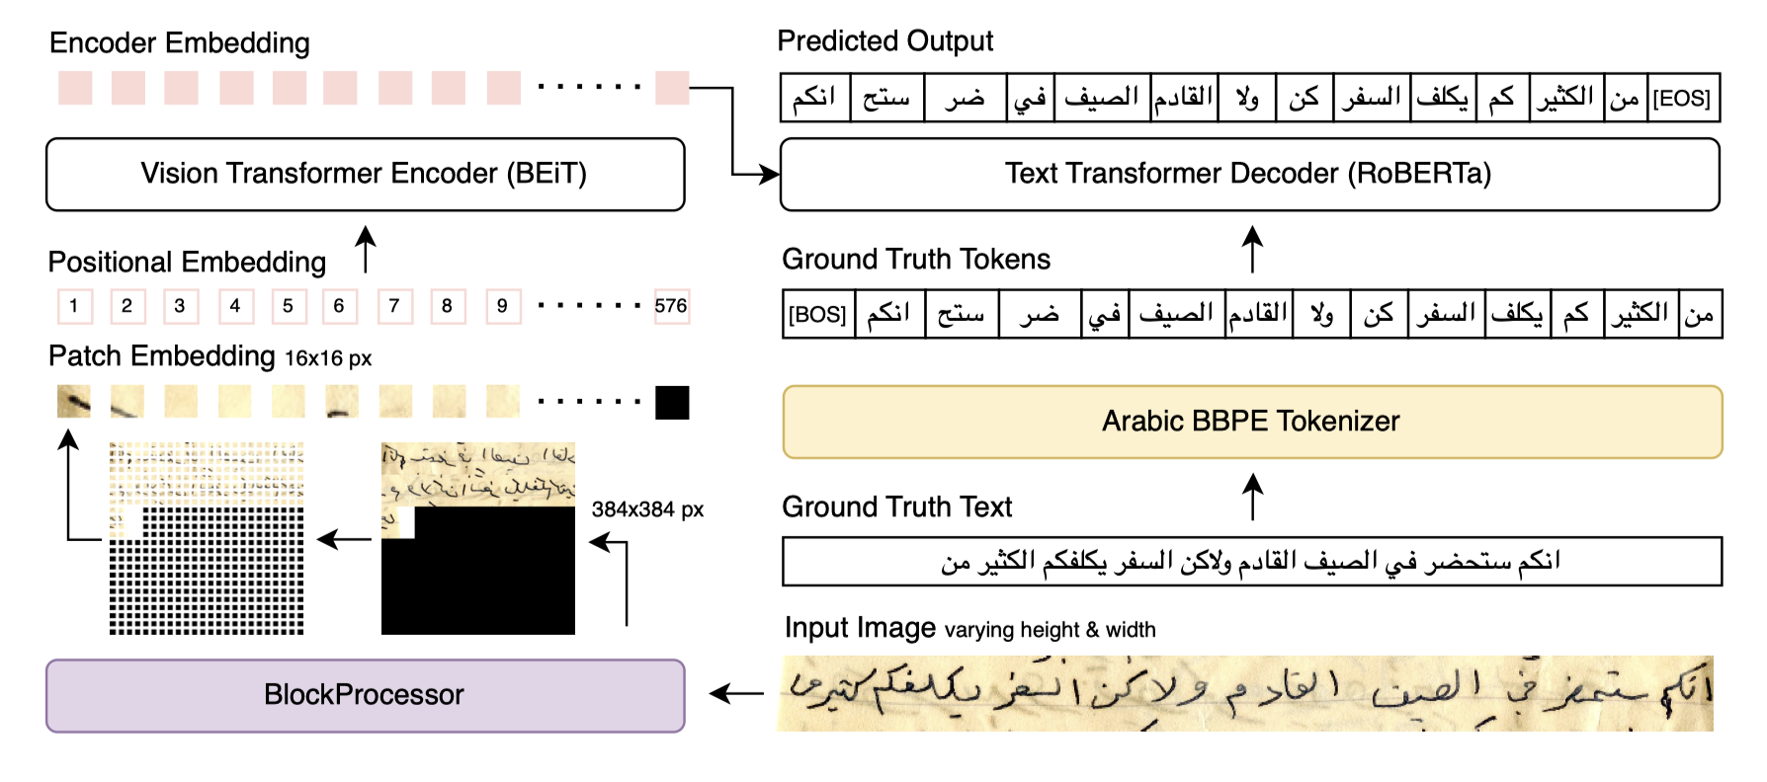
HATFormer : Historic Handwritten Arabic Text Recognition With Transformers [4]
Model Architecture:
Fully transformer-based encoder-decoder model.
Uses Vision Transformers (ViT) to extract visual features.
Employs RoBERTa (Robustly Optimized BERT Approach), a pretrained language model for accurate text decoding.
Innovations:
Introduced a BlockProcessor to preserve image aspect ratios and reduce horizontal information loss.
Developed a custom byte pair encoding (BBPE) tokenizer for compact Arabic text representation.
Observations:
Outperforms traditional CNN-RNN models in recognizing Arabic handwriting.
Trade-off: Higher computational cost due to transformer complexity.
Figure 4: The architecture of HATFormer [4]

Slide 12
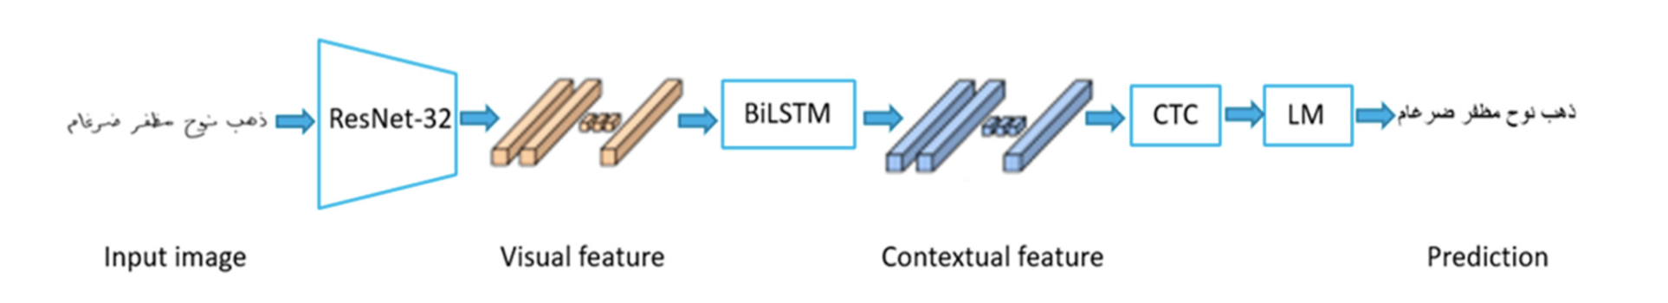
Machine Learning Approach for Arabic Handwritten Recognition [5]
Figure 6: Model Archetecture
Architecture:
Feature extraction with 32-layer ResNet (Residual Network)
Sequence modeling with BiLSTM
Leverages CTC loss and decoding to predict text sequences from visual features.
Post-Processing:
KenLM statistical language model trained on Arabic text
Refines predictions by integrating contextual word probabilities

Slide 13
Methodology
Notes:
Ariel

Slide 14
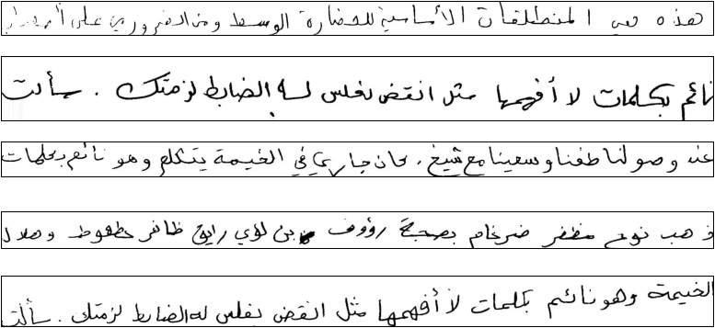
The KHATT [6] Dataset
Origin:
Developed by King Fahd University of Petroleum and Minerals (KFUPM), Saudi Arabia.
Acronym for KFUPM Handwritten Arabic TexT and derived from the Arabic word (خط) meaning "handwriting."
Content:
4,000 handwritten paragraphs contributed by 1,000 writers.
Each writer provided six paragraphs, scanned with ground truth annotations.
Diversity:
Contributors from Saudi Arabia, Morocco, USA, Palestine, Kuwait, Egypt, Tunisia, Yemen, and more.
Wide representation of age groups, educational backgrounds, and genders.
Figure 7: Sample Line Images from the KHATT Dataset [6]

Slide 15
Data Acquisition and Preprocessing
Key Points:
Original KHATT [6] dataset was inaccessible
Acquired a public portion of the dataset from Kaggle [7]
Dataset included preprocessed line-by-line images with corresponding ground truth labels
Preprocessing steps:
Normalized the line images
Resized to 1048x64 (width x height)
Applied horizontal flipping to images and their labels
Notes:
Ariel

Slide 16
Data Preparation
Used two seeds to create an 80-10-10 split for training, validation, and testing
Aggregated labels with sequence lengths under 8 characters to balance sample distribution
Stratified splits based on label lengths to prevent model bias:
Ensured variety in sentence lengths across splits
Avoided over-representation of short labels, improving performance on longer sequences and vice-versa
Augmented the data after splitting and applied it only to the training set

Slide 17
Model Architecture, inspired by [5]
Figure 6: Model Archetecture
ResNet32 as the feature extractor
BiLSTM captures temporal dependencies forward and backward (essential for languages)
CTC loss is for seq2seq tasks to help the model learn to align an input sequence (an image) with an output sequence (text)
CTC Word Beam Search to decode the outputs into character sequences
KenLM is a probability-based language model to help refine the output of the CNN-BiLSTM pipeline based on a given corpus to actually follow real linguistic patterns
Notes:
CTC considers all the VALID ways to align the predicted sequence to the groundtruth
CTC calculates the total probability of all valid alignments that result in the target and encourages the model to give higher probabilities to these alignments
No need to align the each letter in "cat" to specific parts of the image
An input image might have many time steps but the output "cat" is short. CTC bridges this gap
Build with blank tokens and then collapse the predicted, removing the blank tokens and duplicates
Valid alignments always collapse into exactly the target sequence
Invalid alignments have extra characters, missing characters, and characters in the wrong order
This is greedy decoding

Slide 18
Results and Analysis

Slide 19
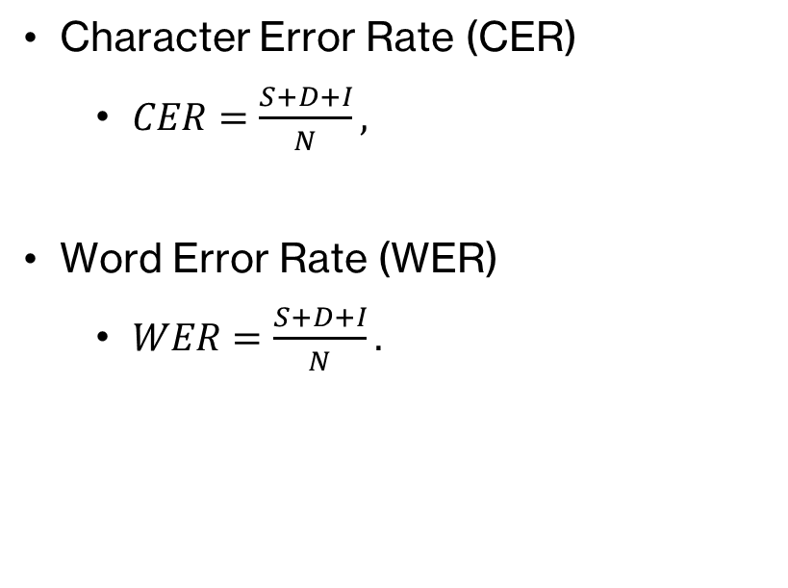
Evaluation Metrics
Character Error Rate (CER)
$CER=\frac{S+D+I}{N},$
Word Error Rate (WER)
$WER=\frac{S+D+I}{N}.$
S = Number of character/ word substitutions
D = Number of character/ word deletions
I = Number of character/word insertions
N = Total number of characters/words in the reference (ground truth)
WER and CER are based on the concept of Levenshtein edit distance, which is the minimum number of edit operations required to transform the output text into the ground truth text.

Slide 20
Experimental Results
 | No KenLM Mean (Std) | 2-gram KenLM Mean (Std) | 3-gram KenLM Mean (Std) | 4-gram KenLM Mean (Std)
Test Loss | 179.60 (7.1050) | - | - | -
CER | 1.9519 (0.1034) | 0.8916 (0.04327) | 0.8887 (0.04667) | 0.8886 (0.04681)
WER | 9.582 (0.6317) | 4.3369 (0.2639) | 4.32285 (0.2804) | 4.3223 (0.2809)
Notes:
Ariel Potential reasons for horrible results:
we dont have the original dataset we introduced a 1x1 convolution to handle the changing filter sizes in the skip connections
We implemented the CTC loss incorrectly

Slide 21
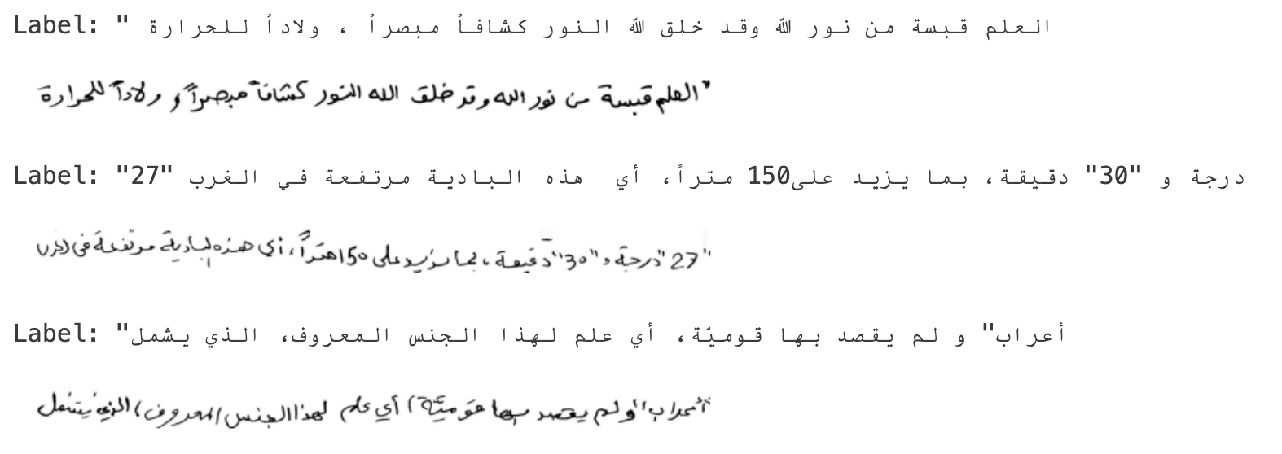
Challenges and Limitations
Limited access to the complete raw KHATT dataset
Insufficient computational resources despite using NVIDIA Quadro 4000 and RTX 3090 GPUs.
Required renting an A100 GPU via RunPod for adequate performance
Difficulties in implementing CTC loss and decoding accurately
Label encoding affected decoding performance:
Dataset used Windows-1256 encoding for Arabic.
Symbols or numbers at the start of a label appeared at the end during decoding.
Figure 7: Sample lines and Correspondiing Label
Notes:
Hamza

Slide 22
Conclusion
Developed a deep learning model for Arabic handwriting recognition
Addressed a critical step in preserving Arabic culture and heritage
Learned about the practical implementation of CTC loss and decoding
Acquired hands-on experience with Optical Character Recognition (OCR) systems
Overcame challenges and expanded knowledge in deep learning and sequence modeling
Notes:
Layth

Slide 23
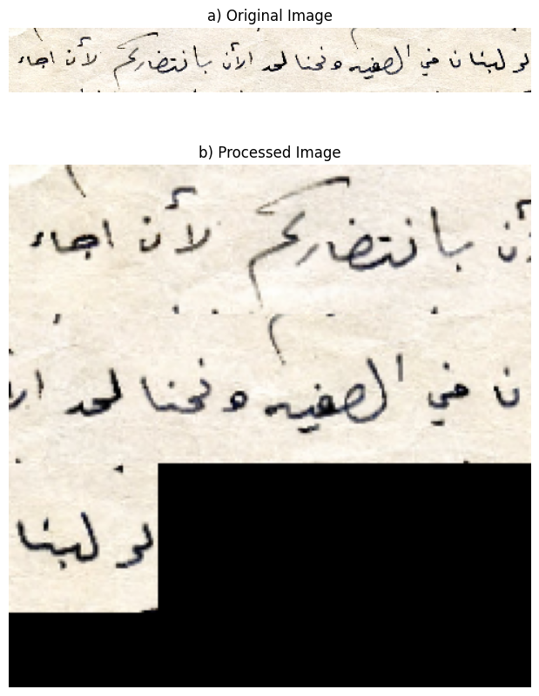
Future Work
Using BlockPreprocessor for input
Obtain access to the full dataset/explore others (potential transfer learning)
Integrate attention mechanisms
Explore positional embeddings
Exploring more avenues of post-processing like LLMs
Explore finetuning different feature extractors
Figure 8: BlockProcessor transformation: (a) Original image and (b) Processed image with resizing and zero-padding, preserving aspect ratio and avoiding information loss.
Notes:
Layth

Slide 24
References
[1] M. Saeed et al., “Muharaf: Manuscripts of Handwritten Arabic Dataset for Cursive Text Recognition,” Jun. 13, 2024, arXiv: arXiv:2406.09630. [Online]. Available: http://arxiv.org/abs/2406.09630
[2] N. Alrobah and S. Albahli, “Arabic handwritten recognition using deep learning: A survey,” Arabian Journal for Science and Engineering, vol. 47, no. 8, pp. 9943–9963, 2022.
[3] L. Mosbah, I. Moalla, T. M. Hamdani, B. Neji, T. Beyrouthy, and A. M. Alimi, “Adocrnet: A deep learning ocr for arabic documents recognition,” IEEE Access, 2024.
[4] A. Chan, A. Mijar, M. Saeed, C.-W. Wong, and A. Khater, “Hatformer: Historic handwritten arabic text recognition with transformers,” arXiv preprint arXiv:2410.02179, 2024.
[5] A. Mutawa, M. Y. Allaho, and M. Al-Hajeri, “Machine learning approach for arabic handwritten recognition,” Applied Sciences, vol. 14, no. 19, p. 9020, 2024.
[6] S. A. Mahmoud, I. Ahmad, W. G. Al-Khatib, M. Alshayeb, M. T. Parvez, V. M¨argner, and G. A. Fink, “Khatt: An open arabic offline handwritten text database,” Pattern Recognition, vol. 47, no. 3, pp. 1096–1112, 2014.
[7] https://www.kaggle.com/datasets/iraqyomar/khatt-arabic-hand-written-lines

Slide 25
Thank you!
Q&A

